Slide 1
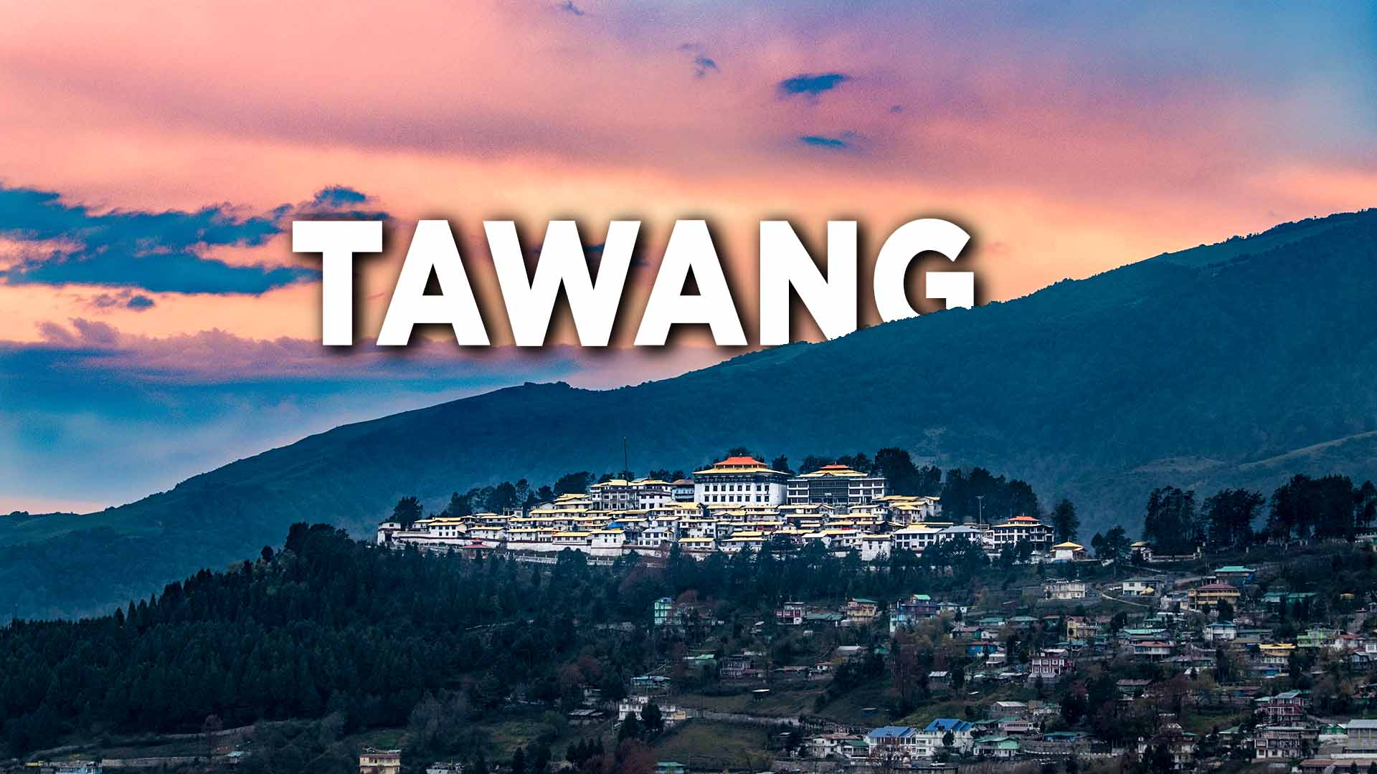
An unexplored diet for nature seekers
Arunachal Pradesh : the land of dawn lit mountains

Slide 2
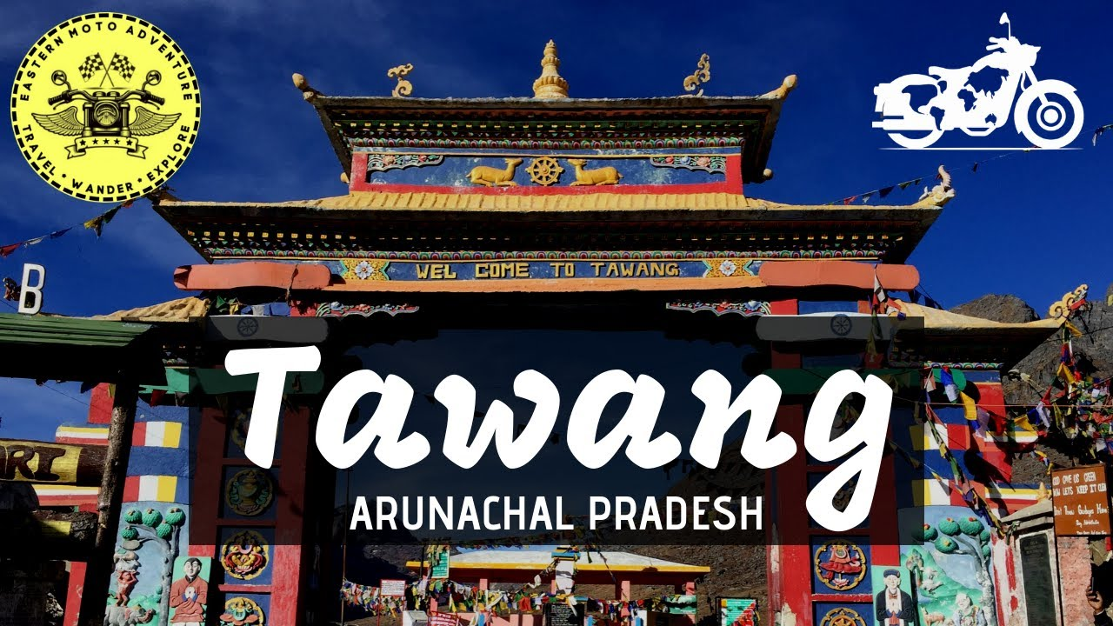
Tawang
The beautiful town of Tawang ,also pronounced as Dawang has many sceneries to make your trip a picturesque one. However, what begins to define the area is its significance for Buddhist monks. Tawang is the place to go for monasteries, with the Tawang Monastery being the most popular one and extremely sacred for the Buddhists. Tawang is a place which will flatter
you with its natural beauty wrapped in the
scent of spirituality.
Tawang is both historically and naturally endowed.

Slide 3
history
Tawang is inhabited by the Monpa people. From 500 BC to 600 AD a kingdom known as Lhomon or Monyul ruled the area. The Monyul kingdom was later absorbed into the control of neighboring Bhutan and Tibet. Tawang Monastery was founded by the Merak Lama Lodre Gyatso in 1681 in accordance with the wishes of the 5th Dalai Lama, Ngawang Lobsang Gyatso,. The sixth Dalai Lama, Tsangyang Gyatso, was born in Tawang.
Tawang was historically part of Tibet In 1938, the British made a cautious move to assert sovereignty over Tawang by sending a small military column under Capt. G.S. Lightfoot to Tawang.After the outbreak of the war with Japan in 1941, the government of Assam undertook a number of 'forward policy' measures to tighten their hold on the North East Frontier Agency (NEFA) area, which later became Arunachal Pradesh
Tibet lost its independence in 1950's and was incorporated into the newly established People's Republic of China. Tibet also lost its independent diplomatic freedom and Tawang was now a stress point between India and China.
During the Sino-Indian war of 1962, Tawang fell briefly under Chinese control, but China withdrew its troops at the end of the war. Tawang again came under Indian administration.
Tawang district was formed in 1989, when it was split from West Kameng district.

Slide 4
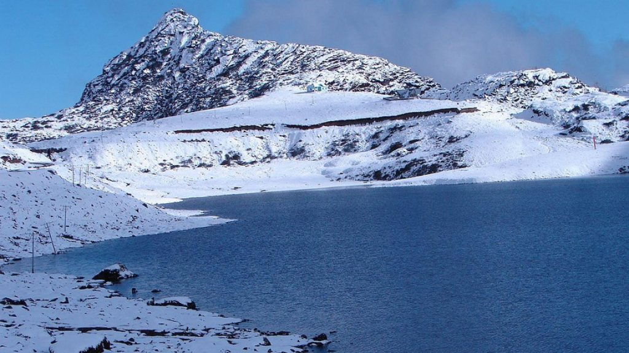
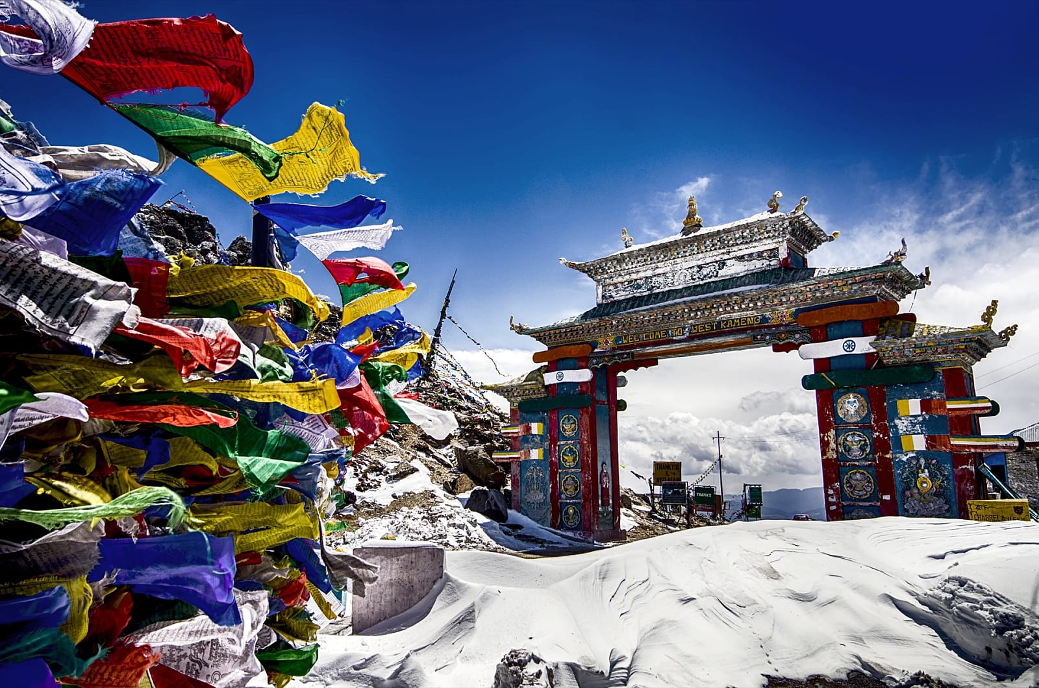
Best time to visit
Summer is best time to visit Tawang. The temperature during this time ranges between 5 degrees Celsius and 20 degrees Celsius. The days are pleasant and nights are colder.

Slide 5

Story behind its name
‘Ta’ means Horse and ‘Wang’ means Chosen.
It is believed that the site on which the monastery has been constructed was chosen by the horse, which was owned by Merag Lama Lodre Gyamtso. According a legend, Merag Lama was unable to decide a location to establish the monastery. In order to seek divine guidance for choosing the construction site for the monastery, he was praying inside a cave. When he came out after finishing prayers, he found that his horse was missing. On searching, he saw that horse was standing on a hilltop. On seeing his horse on the hilltop, he considered this as a sign of divine blessing and finalised that location for construction of the monastery. The construction of this monastery was completed with the help of people residing in the neighbouring villages. At present, those same neighbouring villages are responsible for the upkeep of the monastery.

Slide 6
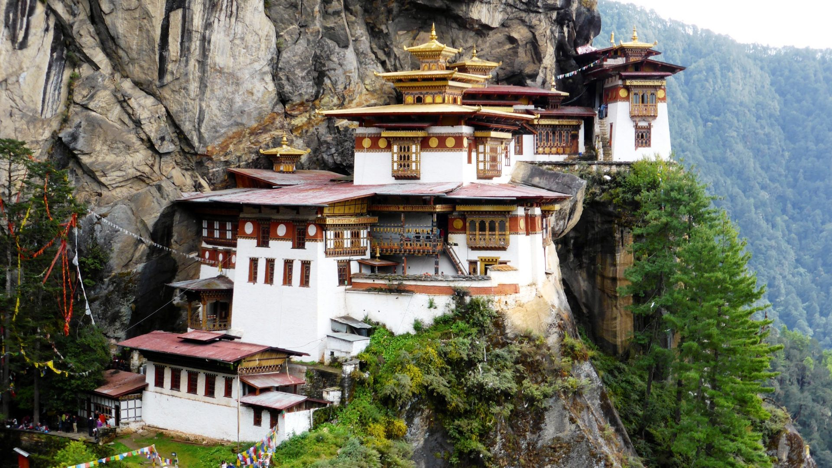
Reasons to explore
Some places rarely crosses 20` C
Monasteries and gompa to meditate
Dizzying peaks and lakes
Snow covered views
Waterfalls
High altitude passes
Birthplace of 6th Dalai Lama
Everything has a story

Slide 7
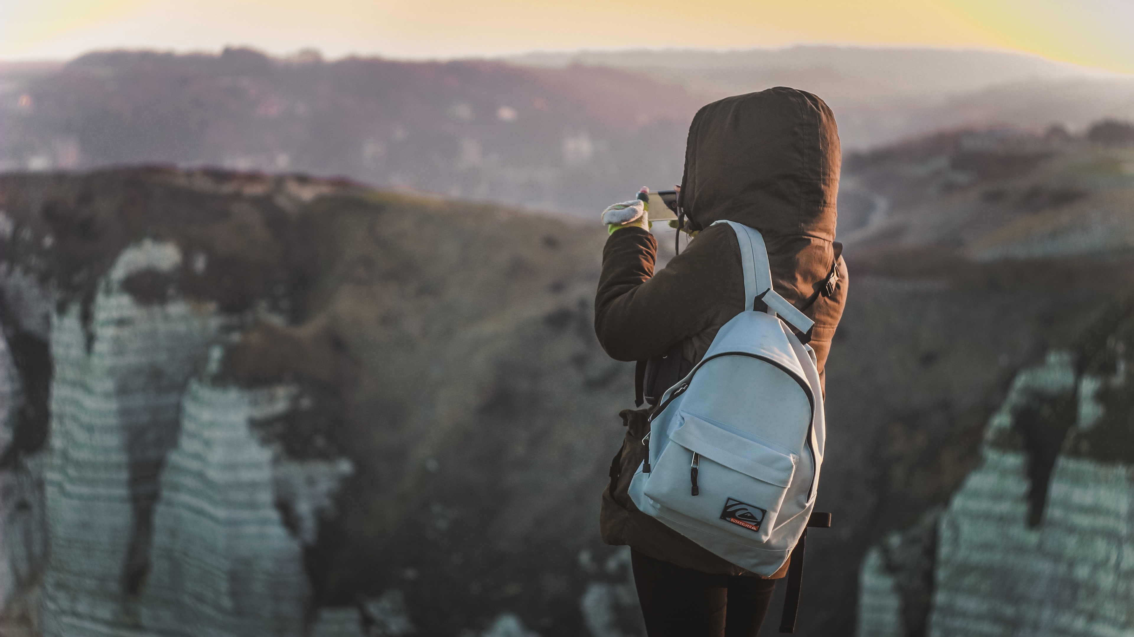
Top attractions to explore

Slide 8
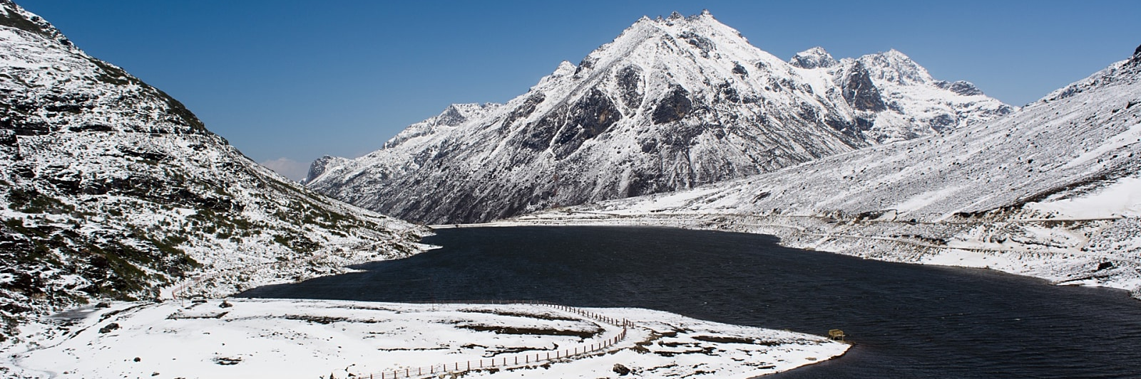
Sela pass
Reckoned for its geographical importance, Sela Pass is located at a height of 4170 m. The awe-inspiring landscapes will help you relax and unwind in the midst of marvelous surroundings. Blessed with a blanket of snow throughout the year, Sela Pass offers some of the most magnificent views of the Himalayan range. The enchanting natural beauty of this rocky pass off your sights of some of the most glorious lakes like the frozen Sela Lake.

Slide 9
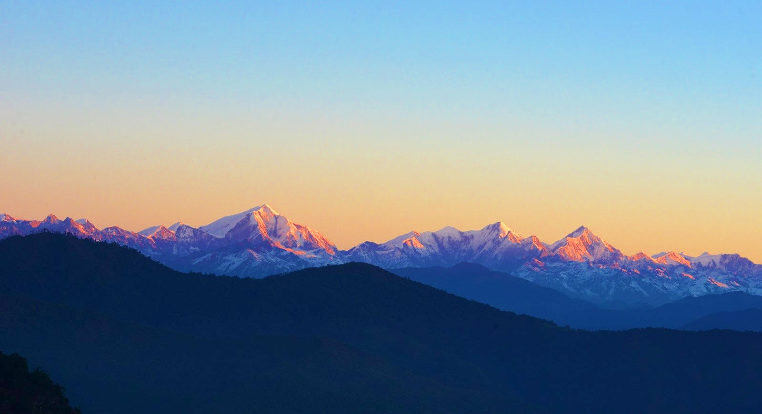
Gorichen peak
Gorichen Peak is the highest peak in Arunachal Pradesh and third highest in the Northeast. This trekking track is blessed with an ideal atmosphere and a landscape to challenge the adventurer in you. Known to be a tough trekking destination, the peak offers beautiful 360-degree views of the surroundings.

Slide 10
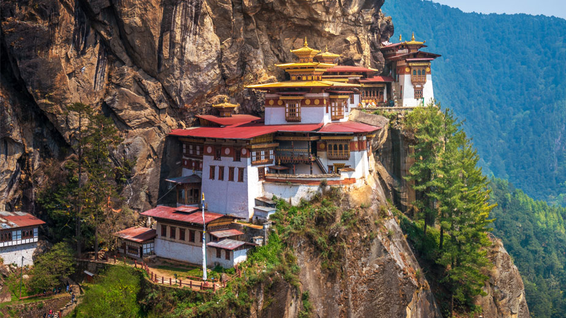
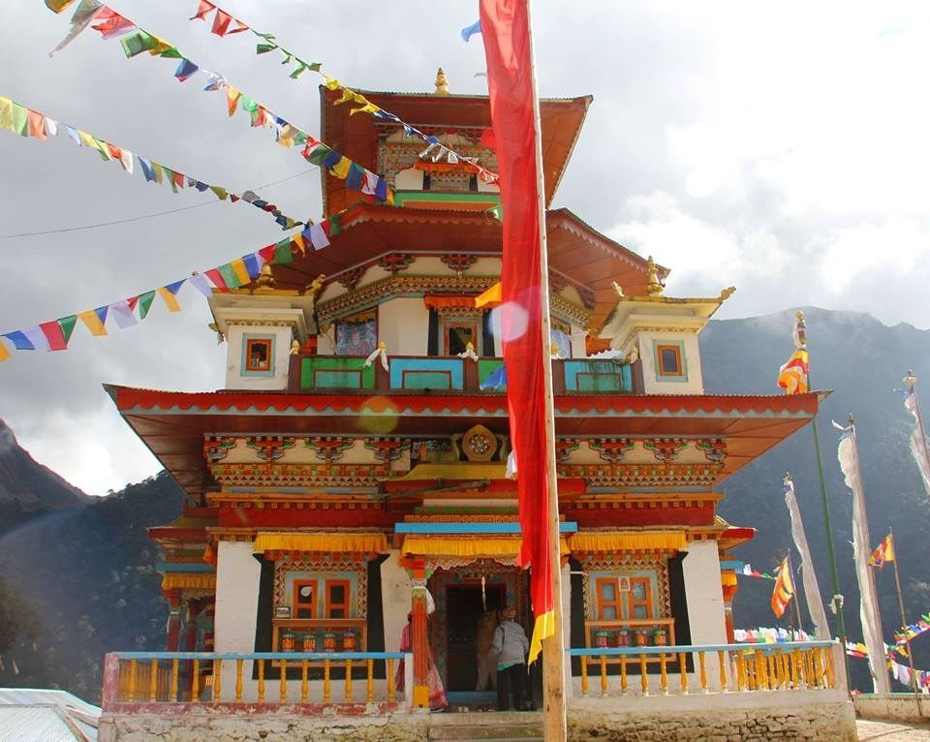
Taktsang gompa
Located atop a hillock at an altitude of about 12,500 to 13,000 feet and surrounded by dense coniferous forest and lofty mountains, this monastery helps you find your inner peace. With its tranquil surroundings, the only sound you hear is of your beating heart and the blowing wind. The overall atmosphere of this place is so calm and soothing that wouldn’t want to leave this place at all.

Slide 11
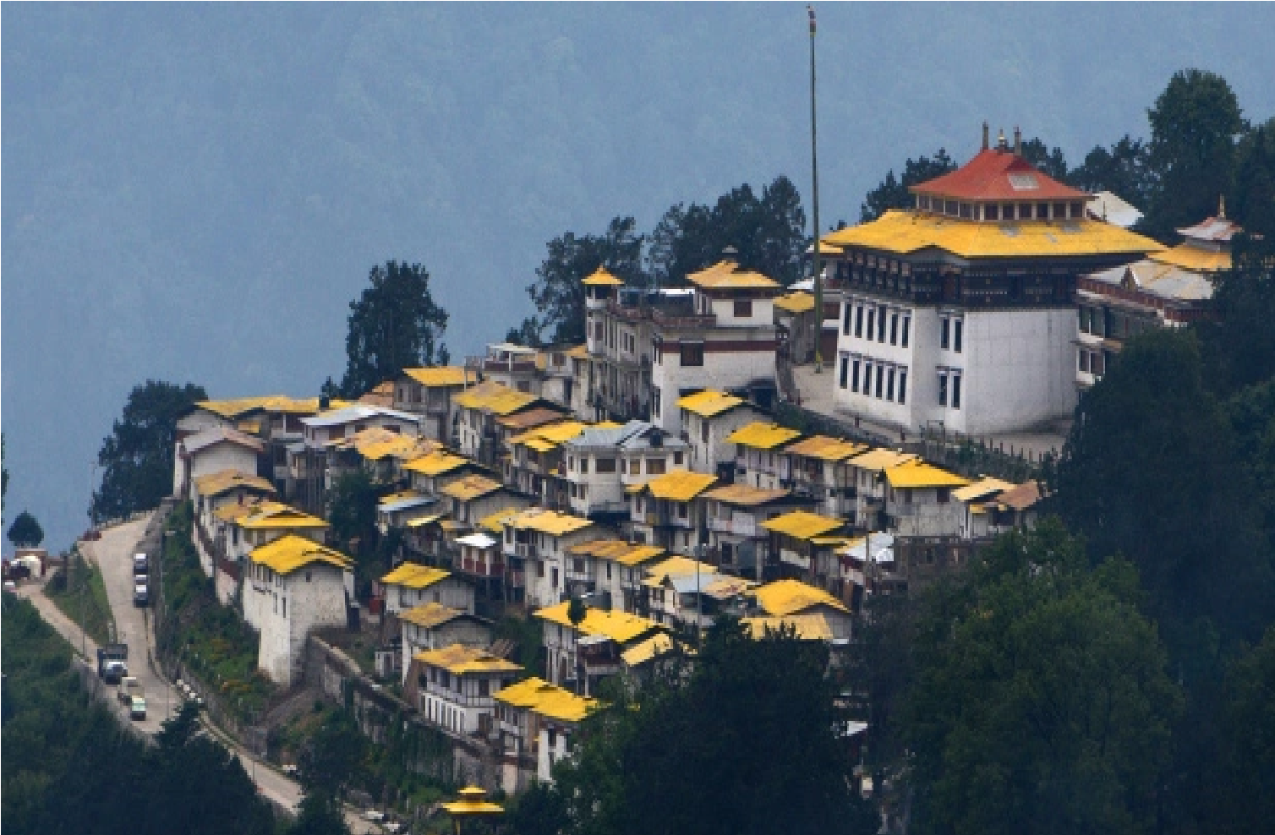
Tawang monastery
Famous as the largest monastery in India and also famous as Galden Namgyal Lhatse, Tawang Monastery is one of the most holy sites for the faith of Mahayana Buddhism. Belonging to the Gelugpa sect of Buddhism, It is home to over 300 monks and holds 17 gompas in the region. Some things to look forward to at Tawang Monastery are sketches and paintings of Bodhisattvas, silver silk casket dedicated to Goddess Shri Devi and many other works of art.

Slide 12
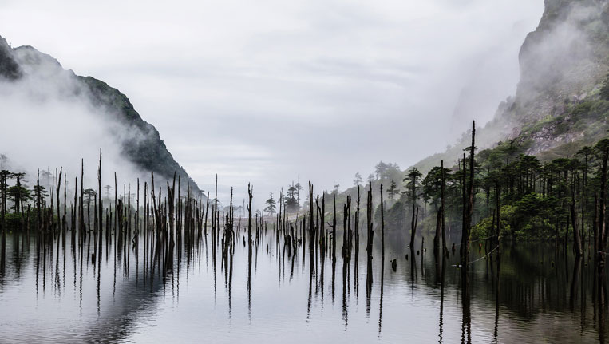
Shong-tser lake
Shonga-Tser Lake is known to be the place where the famous Bollywood song from the movie Koyala was shot.It is also known as Madhuri Lake. A photographer’s delight, Shonga Tser Lake is a remarkable place to enjoy a casual stroll and bask in the serene atmosphere. The awe-inspiring lake is a great crowd puller in Tawang and offers a respite from the noise and pollution of the cities.

Slide 13
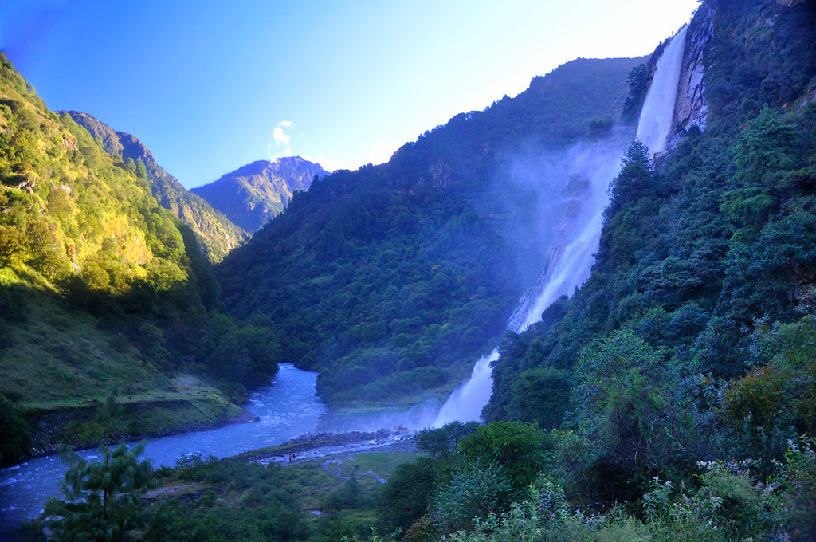
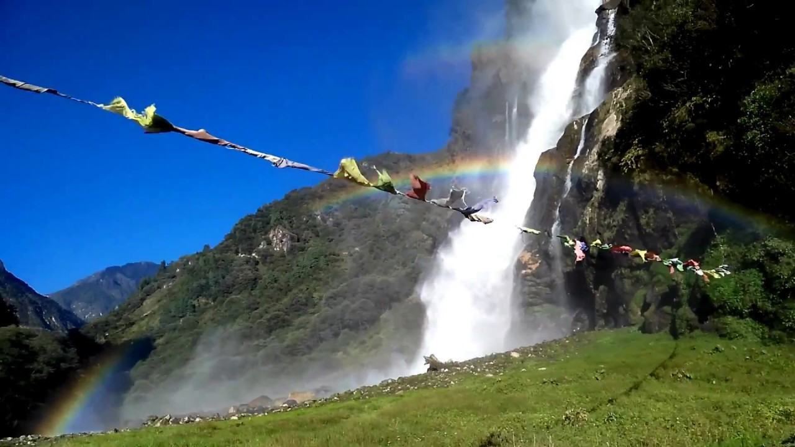
Nurunang falls
Located at a height of 6000 ft above sea level, Nuranang Falls takes you in the middle of untouched forests as you the enjoy the wonder of nature. Encompassed by pristine hills, verdant greenery and a thick cover of mist, Nuranang Falls is one of the must-visit tourist places in Tawang if you are a nature lover looking to relax and unwind.

Slide 14
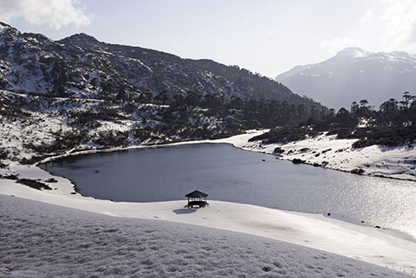
p. Tso lake
Encompassed by blue lapis flowers, Peng Teng Tso Lake is one of the most beautiful places in Tawang. The place boasts of picturesque natural beauty and makes a surreal landscape with the flowers and snow. The calm waters of this serene lake offer a splendid view of the Himalayas that adorn the background.
Maintained by the Indian army, this lake is located 17 km away from the main town and attracts a number of tourists.

Slide 15
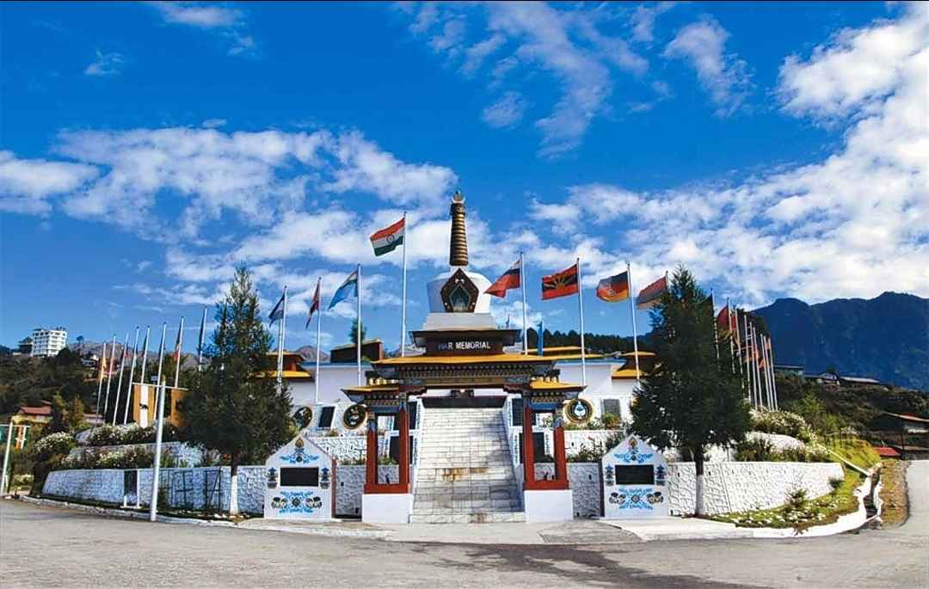
Tawang war memorial
Tawang War Memorial is a wonderful spot among places to visit in Tawang to cherish some patriotic fervor in Tawang. Commemorating the bravery of martyred Indian soldiers who laid down their lives in the 1962 Indo-China War, Tawang War Memorial is an important place to visit when you are there. Built in the memory of 2140 Indian soldiers who laid down their lives in the war, Tawang War Memorial is a fitting place to show your love for the nation and relive those historical events.

Slide 16
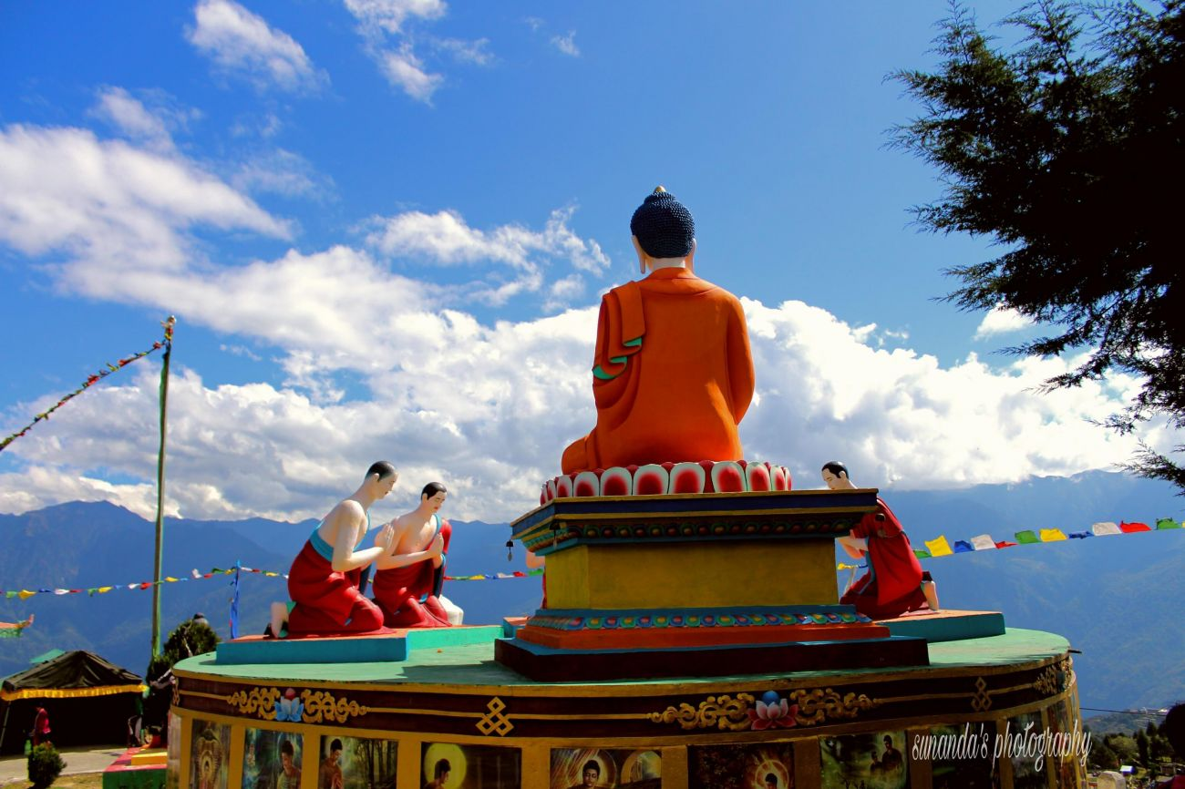

Things to do
Mountain biking
Shop at Tibetan Settlement Market
Hiking at the Gorichen peak
Eat what’s best in area
Travel to sela pass
Meditate in the monastery in the midst of clouds
Sunset at shonga-tser lake

Slide 17
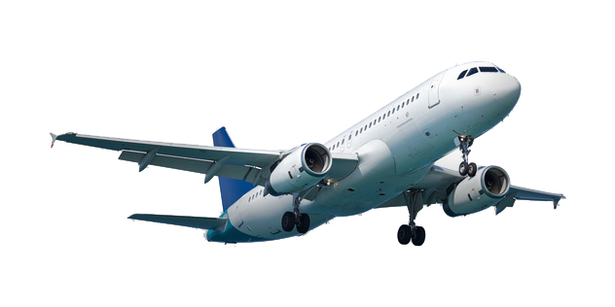

How to reach
By air
Nearest airport from Tawang is located in Tezpur (Salonibari Airport) at a distance of 387 km. In October 2014, Government of Arunachal Pradesh started helicopter facility to connect Tawang and Guwahati. The service is available twice a week
By road
Best way to reach Tawang through road is via cab or bus services. Arunachal Pradesh State Road Transport Corporation (APSRTC) and other private agencies have introduced regular bus services, most of which connect Tawang to Tezpur (319 km), Bhalukpong (262 km), Nagaon (383 km), Missamari (320 km), East Kameng (381 km), Dhula (420 km), Itanagar (440 km), Sagali (502 km), Udalguri (390 km) and other towns and cities.
By train
Nearest railway station from Tawang is Rangapara Railway Station, at a distance of 383 km. It is well connected to major cities and towns of North-east India. About 88 stations are directly connected to Rangapara Railway Station.

Slide 18

By :
Chirag Kapoor
00911804418
MCA 4th Sem

